Slide 1
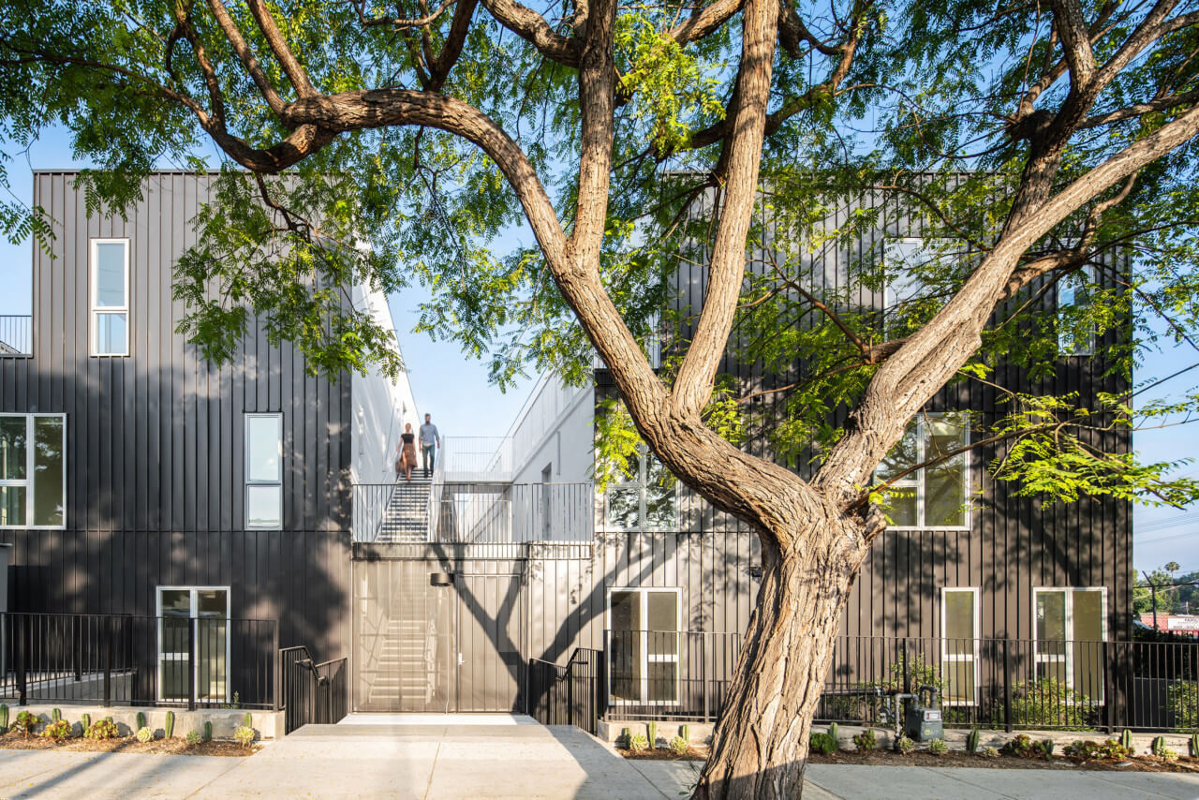
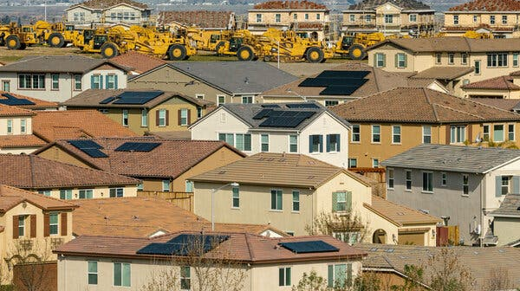
Lessons learned and long overdue reforms in U.S. housing policy
Shane Phillips
6 December 2023

Slide 2
“The Americans can always be trusted to do the right thing, once all other possibilities have been exhausted.”
—Winston Churchill*
*Probably apocryphal, but a great quote in any case
Notes:
Note that a lot of what’s happening in California is not necessarily because we’re so great, but because we’ve let things get so bad that we’ve finally been left with no choice but to act

Slide 3
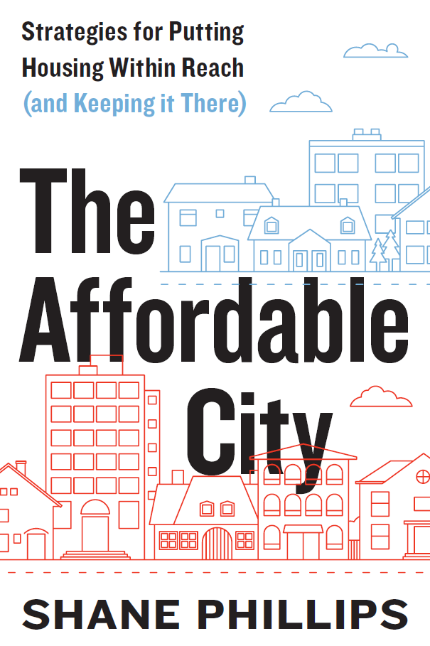

Slide 4
Presentation Outline
U.S. housing market context
Growing appreciation for the consequences of:
Housing scarcity
Maintaining local control
Waiting to act
Missing the middle

Slide 5
U.S. Housing Market Context
Declining production, rising prices

Slide 6
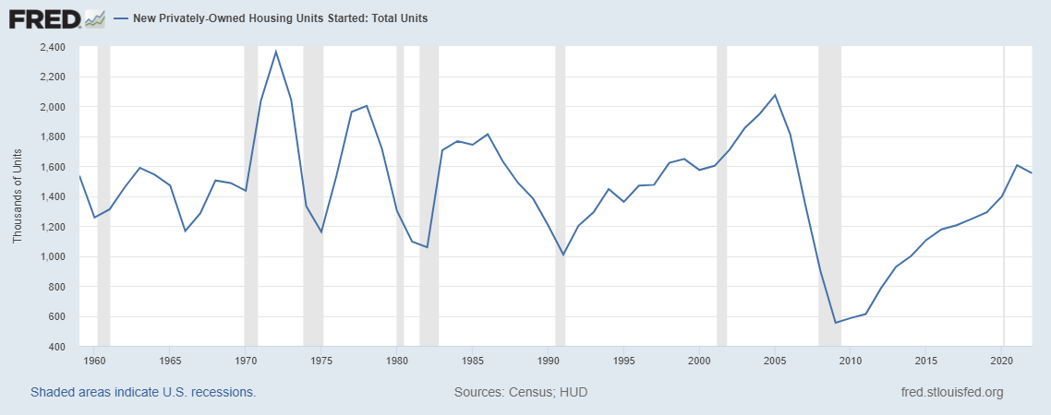
A decades-long trend of declining housing production

Slide 7
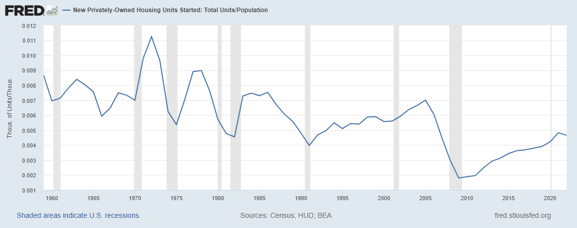
Population-adjusted housing production…

Slide 8
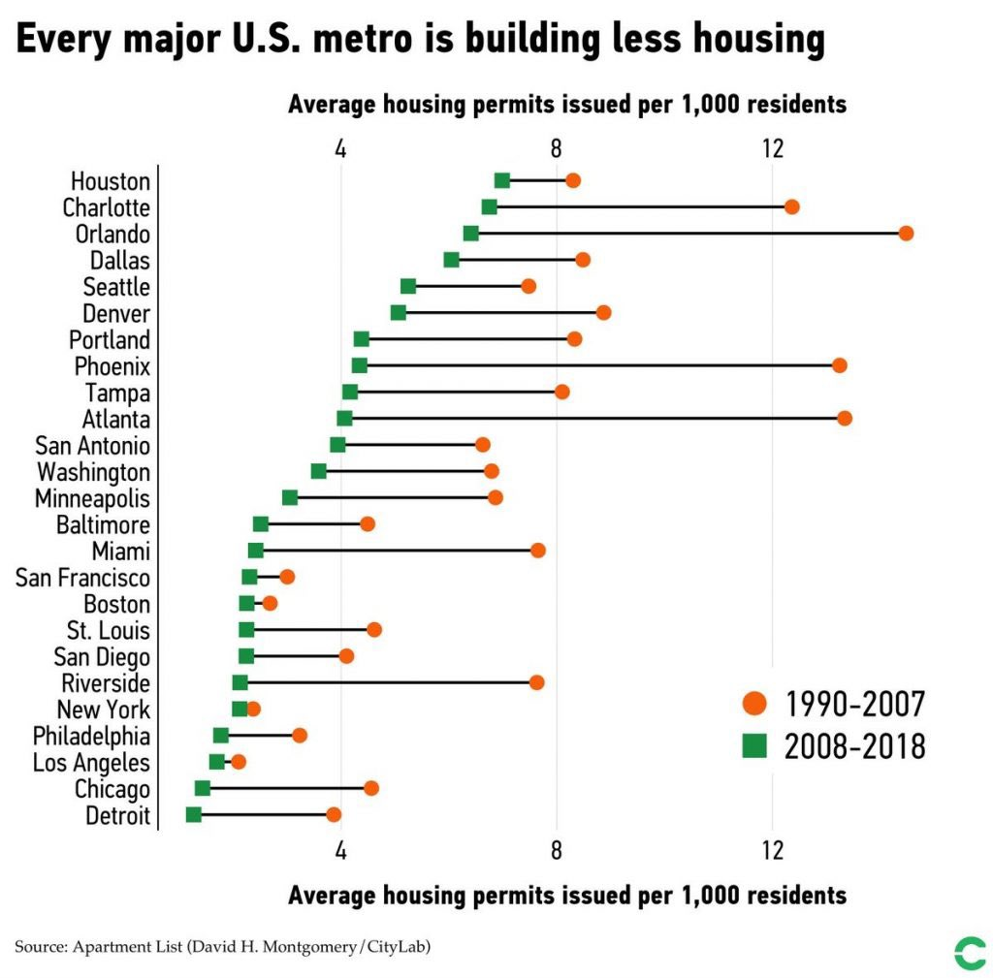
Declining housing production is widespread

Slide 9
Longstanding coastal affordability problems, worsening affordability across the country
Source: American Community Survey 1-year data, 2015 and 2022

Slide 10
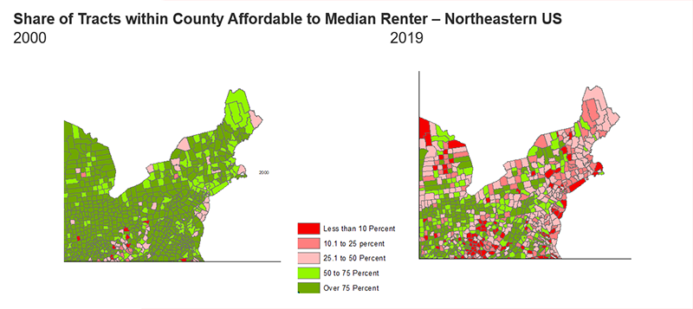
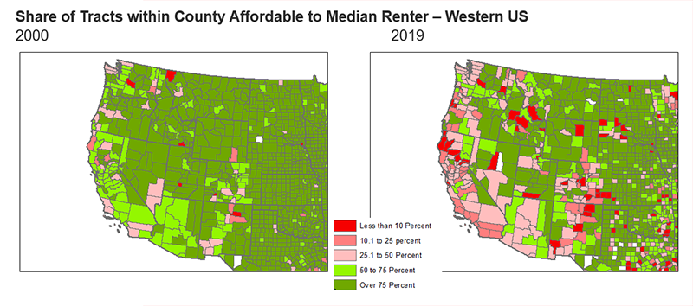
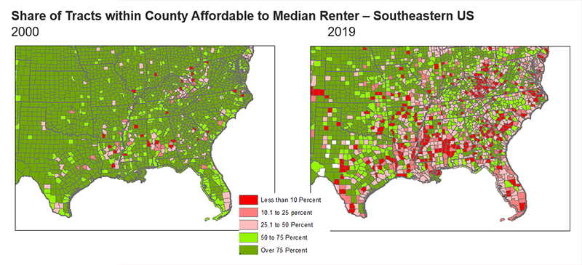
Housing unaffordability is a nationwide problem
Source: Joint Center for Housing Studies, “As Low-Cost Units Become Increasingly Scarce, Low- and Moderate-Income Renters Are Losing Access to Many Neighborhoods”
Notes:
Rising prices are a problem not only in the places where they’re rising fastest, but for more affordable places too
Expensive places end up exporting people to more affordable places, spreading the problem

Slide 11
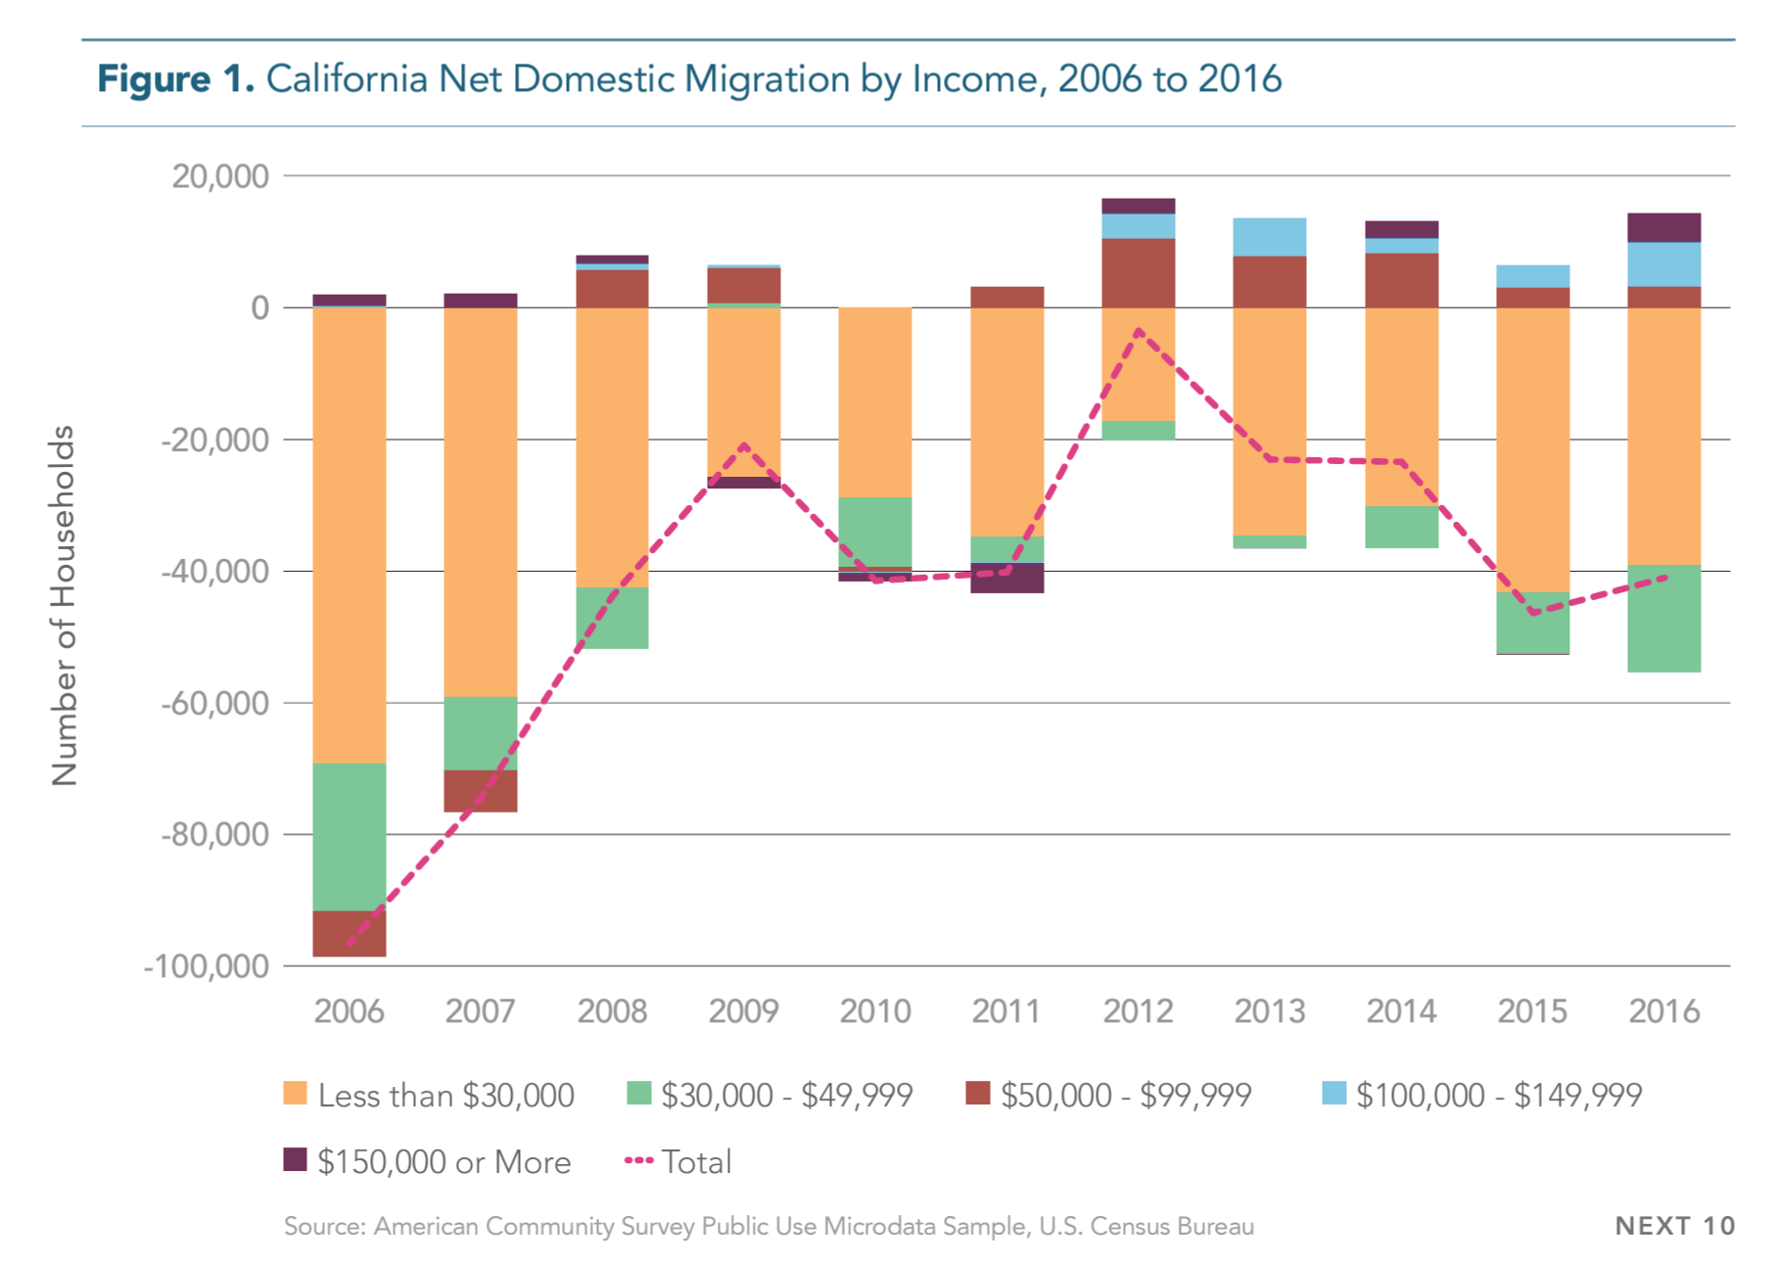
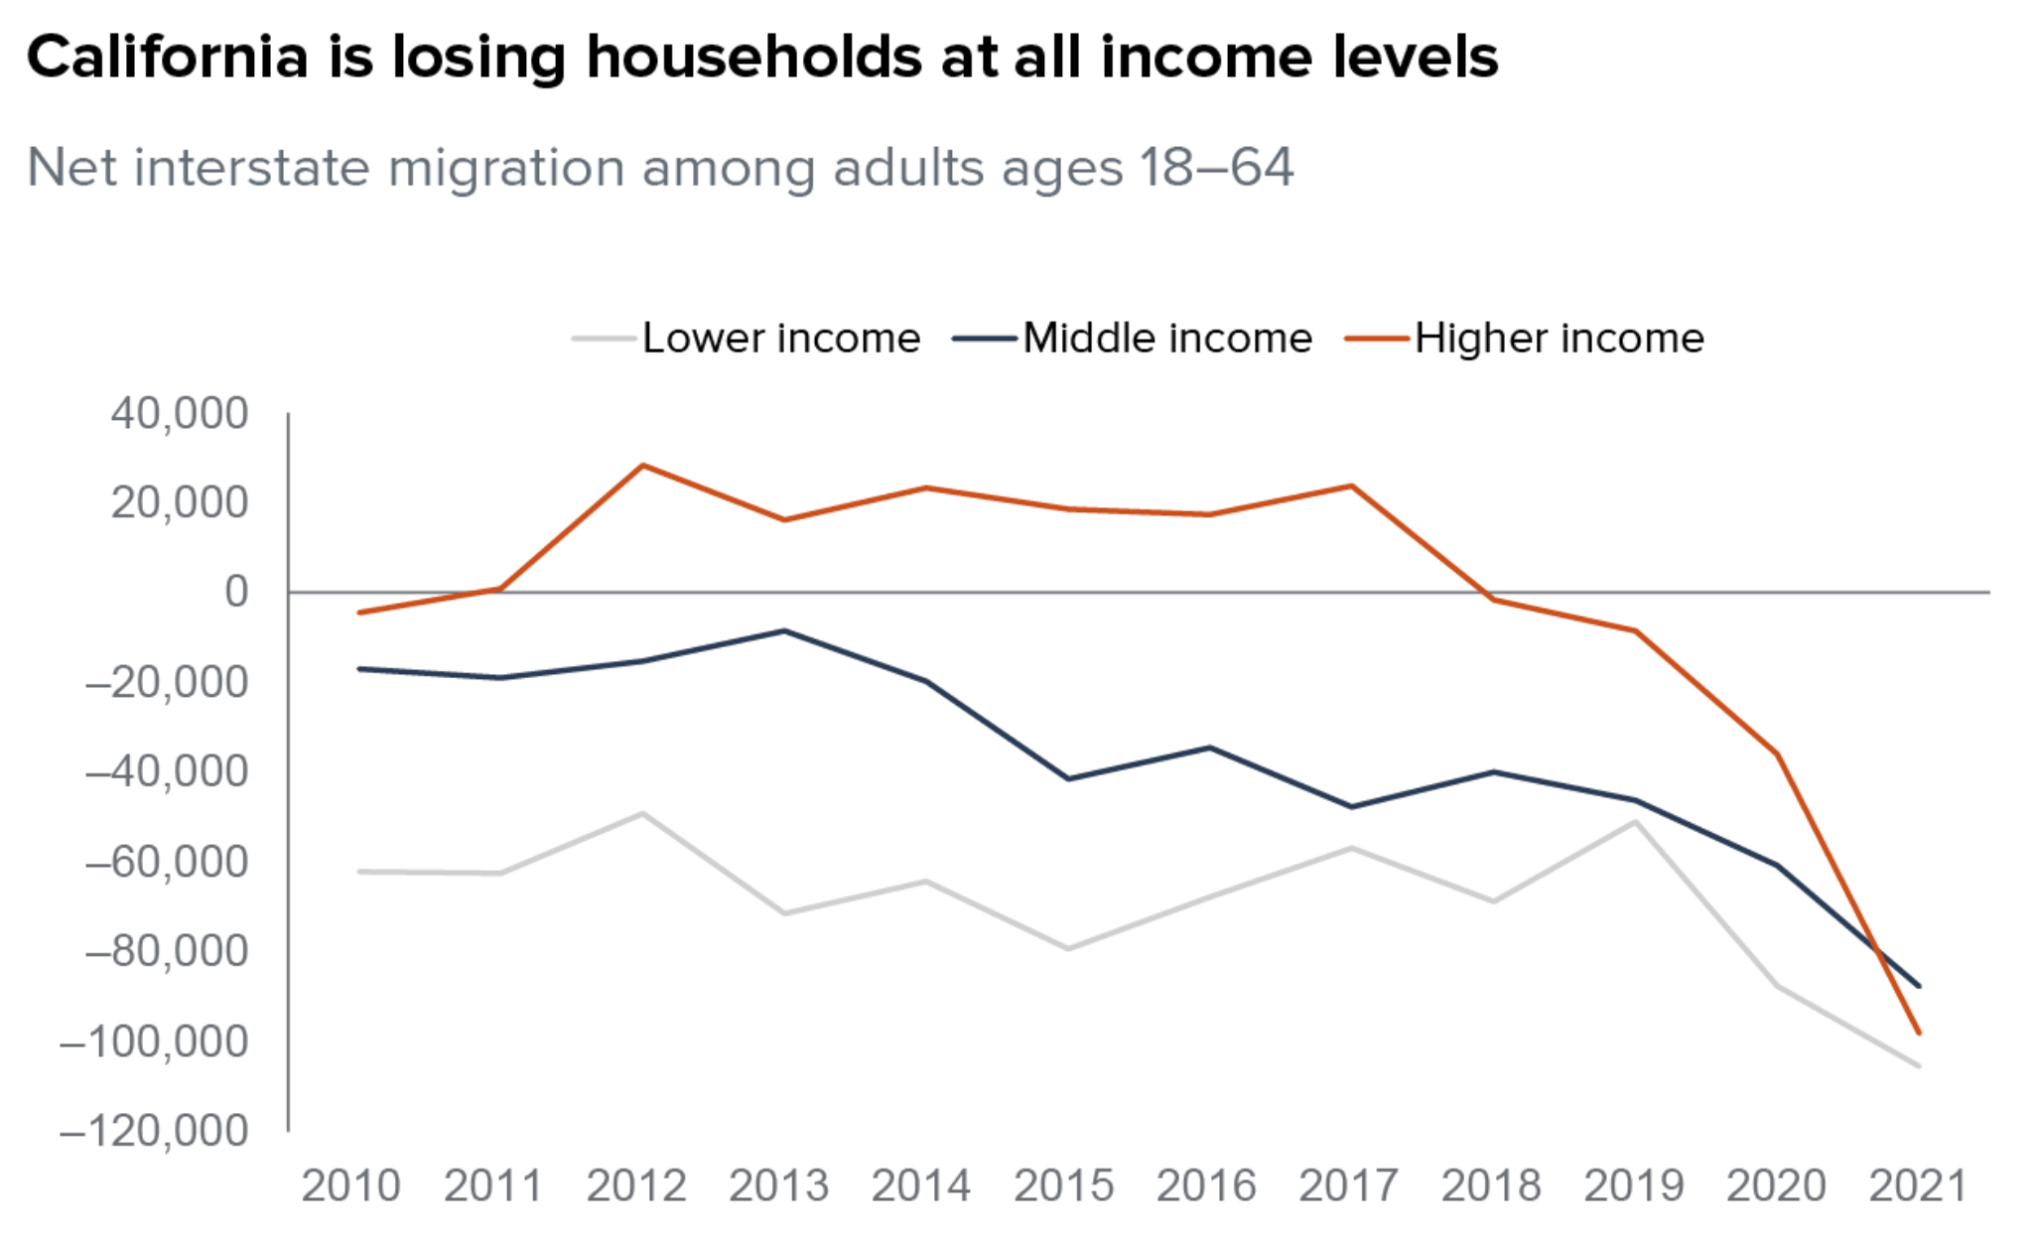
Low & mod. income households are leaving California (and likely other coastal states) due to high housing costs
Notes:
Important in part because of how many good jobs and how much less environmental impact coastal cities and states have
20 cities with highest ratio of median home valuae to median household income had average median household income of $64k in 2015
That increased by 46% by 2022
Next 20 cities by ratio score had average median household income of $54k, which went up by 43% by 2022
By cities 61 through 80 you had an average income of $51k in 2015 that increased by only 33% by 2022
A widening gap

Slide 12
Housing Scarcity
A growing understanding and acceptance of how homebuilding impacts affordability

Slide 13
Limited housing supply is associated with higher prices; homebuilding is associated with lower prices
Research:
Saks (2008)
Kok, Monkkonen, and Quigley (2014)
Gyourko and Molloy (2015)
Hilber and Vermulen (2016)
Been, Ellen, and O’Regan (2019)
Greenaway-McGrevy (2023)
Mense (2023)*
*Not yet peer reviewed

Slide 14
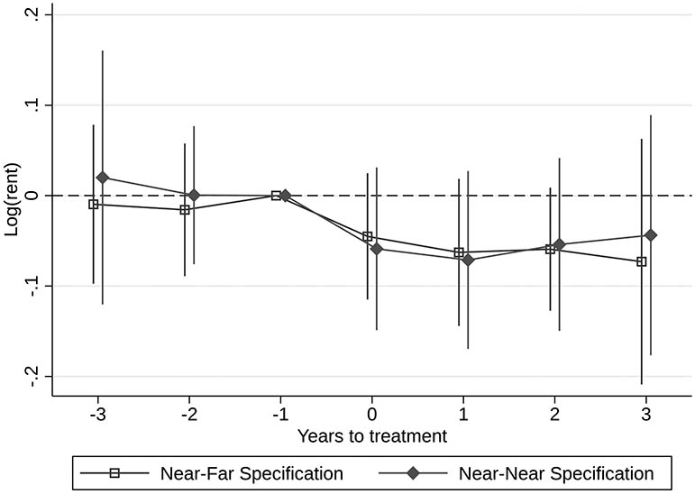
New research shows building homes lowers rents at the block and neighborhood level
Research:
Pennington (2021)*
Li (2022)
Asquith, Mast, and Reed (2023)
Bratu, Harjunen, and Saarimaa (2023)
*Not yet peer reviewed
Source: Asquith, B. J., Mast, E., & Reed, D. (2023). Local effects of large new apartment buildings in low-income areas. The Review of Economics and Statistics, 105(2), 359-375.

Slide 15
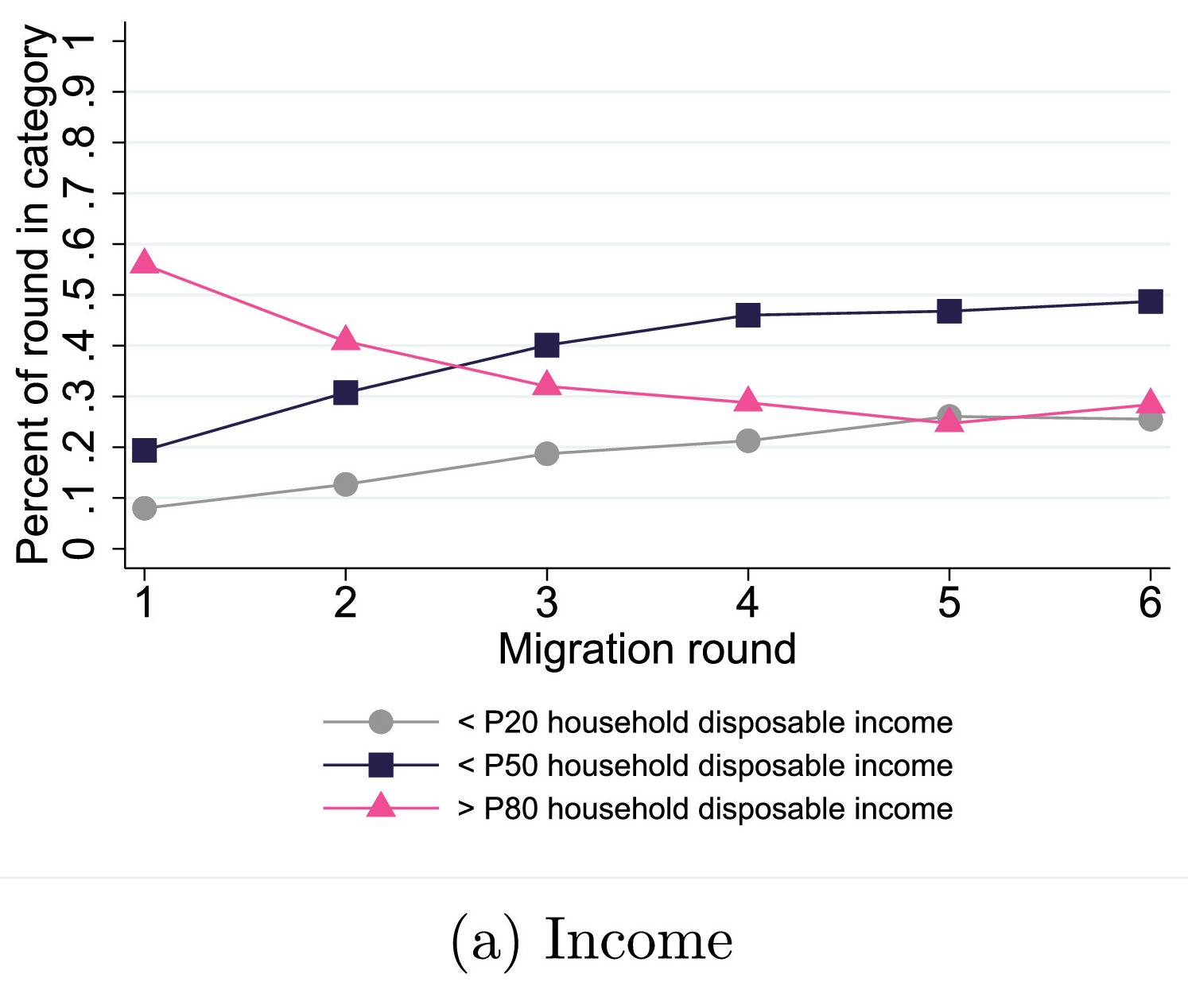
Migration chains illustrate how new (market-rate) homes benefit households at all income levels
From Bratu, Harjunen, and Saarimaa (2023)
Nearly 60% of households moving into new market-rate homes in Helsinki are above the 80th percentile for income
20% are below the Helsinki metro’s median income
By round 6, 50% are below median income, including 25% below the 20th percentile

Slide 16
We know that housing becomes unaffordable when we don’t build enough of it. So why aren’t we building more?
Notes:
Note that a lot of what’s happening in California is not necessarily because we’re so great, but because we’ve let things get so bad that we’ve finally been left with no choice but to act

Slide 17
Local Control and State Preemption
Municipal obstinacy and delay motivates intervention by state legislatures

Slide 18
We have a collective action problem
Individual jurisdictions internalize the benefits of housing scarcity and externalize the costs
Home values and rents go up, making property owners wealthier
Poor people get priced out, becoming someone else’s problem
Well-meaning cities can do everything in their power to improve affordability and still fail if their neighbors don’t contribute
Result: Few are motivated to act, yet we all pay the costs of inaction (though unequally)

Slide 19
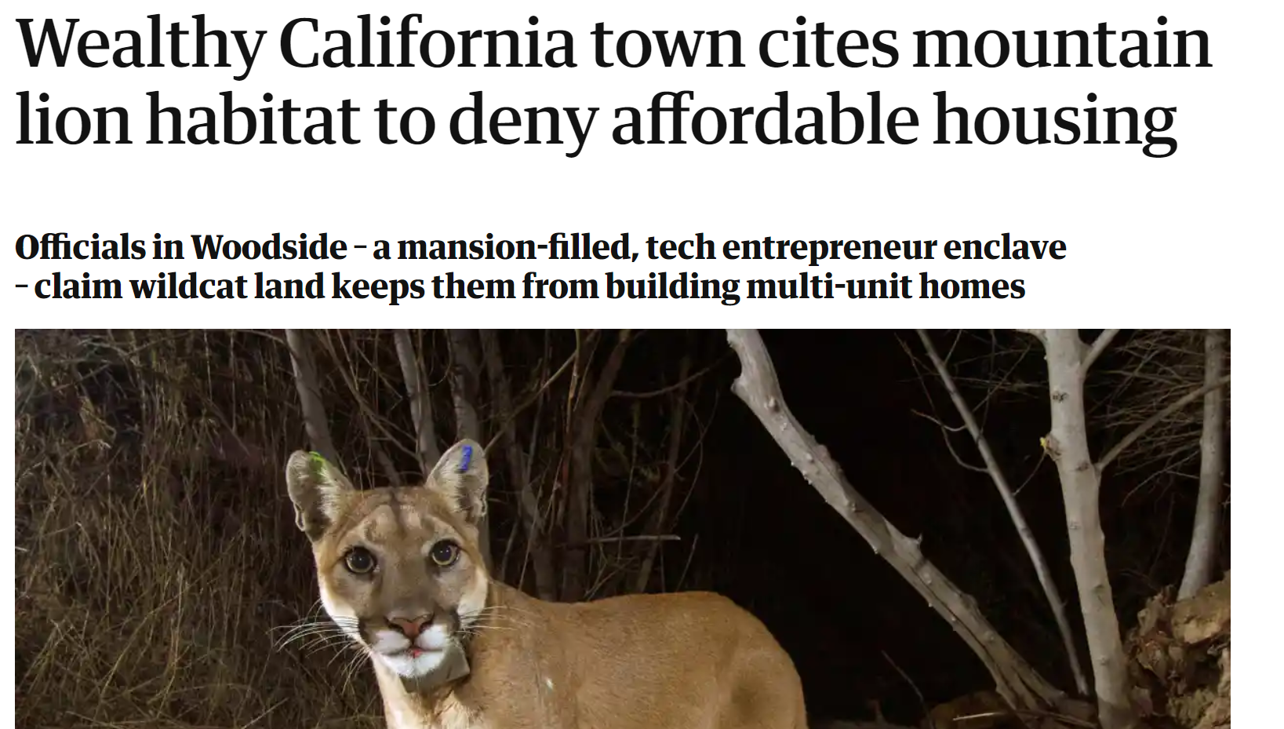
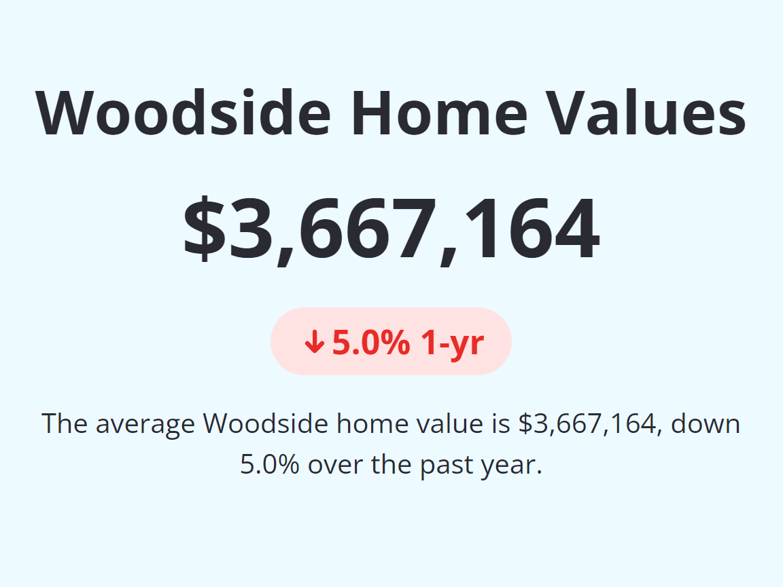
Most cities and suburbs are unwilling to act to solve the housing crisis

Slide 20
Collective action problems are compounded by municipal fragmentation
Los Angeles County (pop. 10 million) has 88 cities
What happens if the City of LA (in white) acts boldly but the other 87 drag their feet?

Slide 21
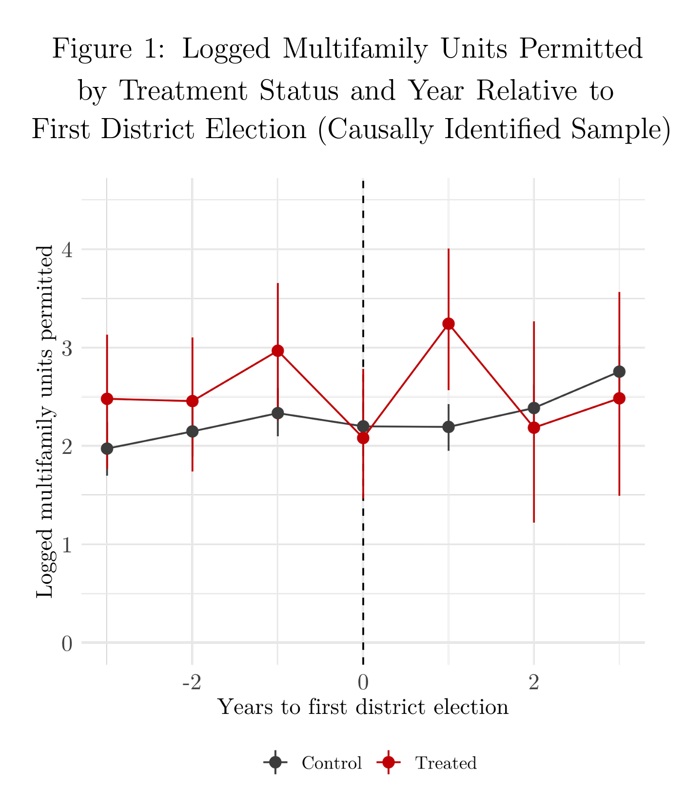
Local decision-making results in fewer housing permits
Hankinson and Magazinnik (2023)
A 2001 state law required many California cities to switch from at-large to district elections
Multifamily permits fell by 55% compared to control cities (p = .08)
In cities with high segregation or electorally underrepresented racial minorities, multifamily permits fell by over 70% (p < .05)

Slide 22
But there’s good news…
Notes:
Note that a lot of what’s happening in California is not necessarily because we’re so great, but because we’ve let things get so bad that we’ve finally been left with no choice but to act

Slide 23
In lieu of local action, states are taking the lead
In 2016-17, California effectively ended single-family-only zoning with new accessory dwelling unit (ADU) laws
The State of Oregon passed two first-of-their kind bills in 2019:
House Bill 2001, requiring cities to allow two or four units per parcel in most cities
Senate Bill 608, limiting annual rent increases to inflation + 7% and prohibiting most “no-fault” evictions
California followed in late 2019, limiting annual rent increases to inflation + 5% (AB 1482), and in 2022 required cities to allow four dwellings per parcel statewide (SB 9)
In 2022, California eliminated parking requirements near transit and required cities to allow up to 80 units/acre (~32 unit/ha) along commercial corridors
Notes:
Marrying supply policy with stability policy

Slide 24
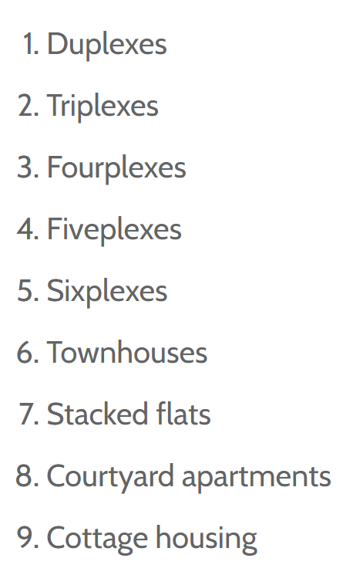
Other states are joining in on pro-housing reform
Washington’s 2023 law, HB 1110, requires cities with at least 75,000 people to allow at least 4 units on each residentially-zoned parcel, or 6 near transit
It must also allow at least 6 of these 9 housing types →
Montana’s package of bills legalizes ADUs, allows housing in commercial zones, and requires cities to select at least 5 pro-housing reforms from a list of 15
Vermont’s bill, S. 100, reduces minimum lot sizes, legalizes 2- and 4-unit buildings, and reduces parking
Colorado, Arizona, and New York proposed ambitious housing packages that didn’t pass (yet)

Slide 25
State mandates usually start with city leadership
States learn what does and doesn’t work by observing cities
The City of Minneapolis ended single-family zoning before the State of Oregon (then California, Washington, Montana…)
“Just cause” eviction protections and rent control policies existed in many cities for decades before Oregon or California adopted them statewide
California’s parking reform law (AB 2097) was preceded by hundreds of local ordinances reducing or eliminating parking requirements
Countless other examples of local policy innovation/success scaled up to the state level
Notes:
We saw something similar happen in Washington state, where in 2015 in Seattle a diverse stakeholder group put together 65 recommendations to grow the housing supply, improve household stability, and increase revenues for low-income housing, and that stakeholder group became the seeds of a grassroots coalition that

Slide 26
One thing included in many city- and state-level housing reforms is…
Notes:
Note that a lot of what’s happening in California is not necessarily because we’re so great, but because we’ve let things get so bad that we’ve finally been left with no choice but to act

Slide 27
Missing Middle
Small and mid-sized infill development makes a comeback

Slide 28
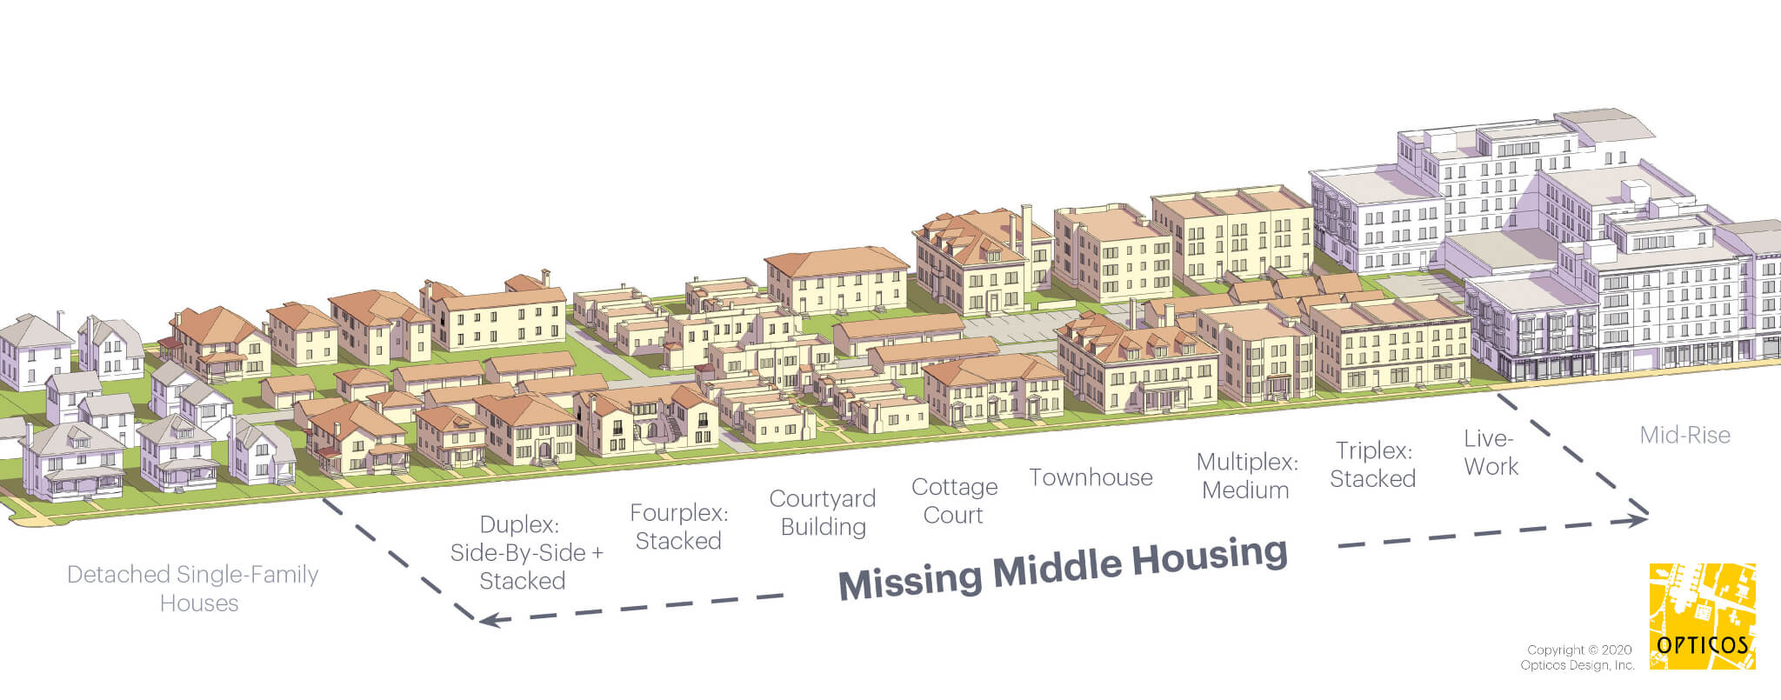
The space between single-family and larger apartments

Slide 29
Small multifamily buildings have been disappearing from the U.S. development landscape
Notes:
64% of our housing stock built before 1940 and only 31% of the housing stock built since 2000

Slide 30
Missing middle housing is (relatively) affordable housing
Source: American Community Survey 1-year data, 2022

Slide 31
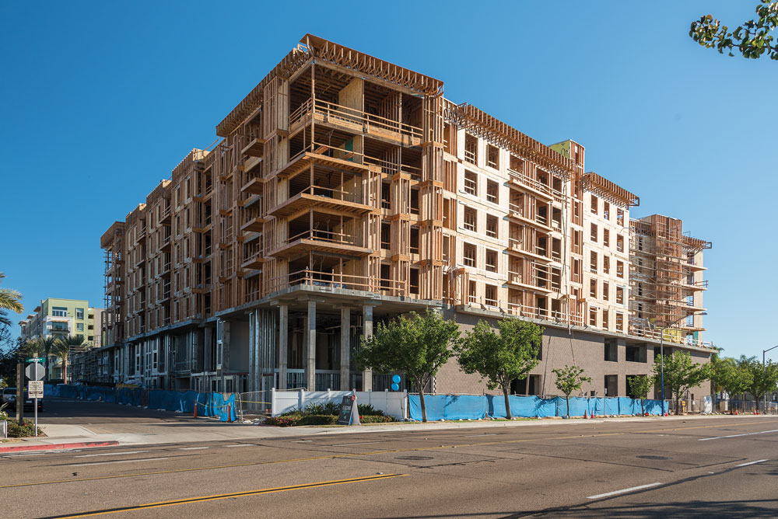
Missing middle saves on land and construction costs
Most housing construction in the U.S. is wood-framed
Over 7-8 stories, housing is built from concrete or steel, costing ~50% more per square foot
Missing middle allows for low-cost construction while also dividing land costs between multiple households

Slide 32
A related concept, and strong complement to missing middle housing: broad upzoning.
Notes:
Note that a lot of what’s happening in California is not necessarily because we’re so great, but because we’ve let things get so bad that we’ve finally been left with no choice but to act

Slide 33
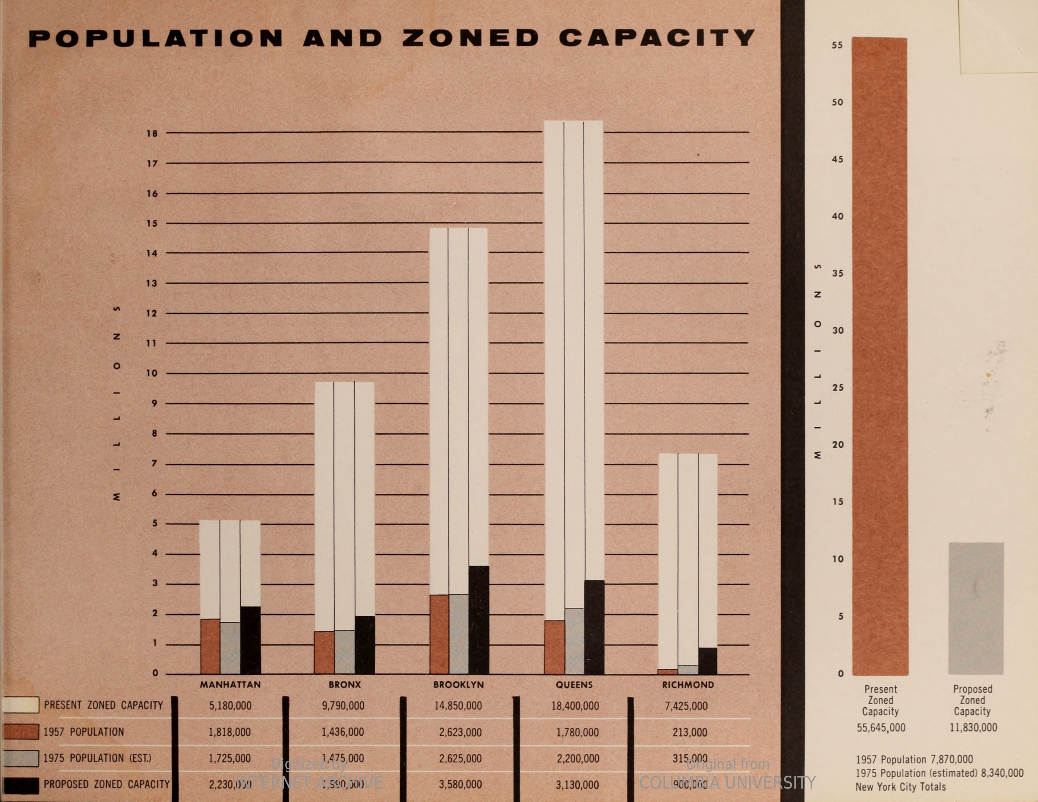
One reason housing development has gotten more expensive is because development sites are scarce
U.S. city development standards used to be very permissive
In 1957, NYC had a pop. of 7.5 million and zoned capacity to accommodate over 55 million
Downzoning restricted supply, but it also drove up the scarcity of development sites — and therefore their price

Slide 34
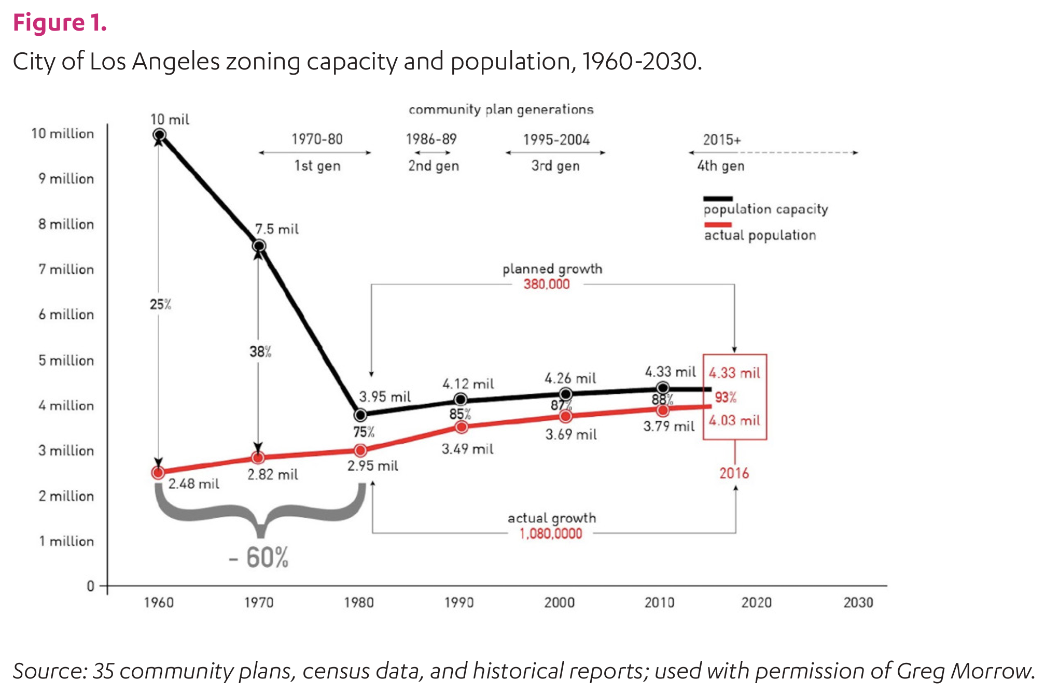
Broad upzoning may create development opportunities without increasing land prices
Since downzoning our cities, we have only added new capacity incrementally (see Los Angeles)
We have concentrated capacity in limited areas, leading to high land costs (scarcity) and construction costs (height)
Allowing middle densities across our cities solves both problems

Slide 35
Paraphrasing Strong Towns’ Charles Marohn…
We’ve created a system of housing production (and urban planning generally) that is orderly, but dumb.
We should return to an approach that is more chaotic, yet smart, with better outcomes for the things we value most.

Slide 36
Spokane, WA (pop. 230,000) approved maybe the most ambitious U.S. housing reform in decades
On every residentially-zoned parcel in the city:
No maximum dwelling unit density on parcels under 2 acres (0.81 ha)
Minimum lot size of 1,200 square feet (111 sq m)
65% lot coverage
40 foot (12 m) height limit
10 foot (3 m) front setback and 3 ft side setbacks
No floor area limits
Parking waived and other bonuses within 1/2-mile (0.8 km) of transit
Notes:
We saw something similar happen in Washington state, where in 2015 in Seattle a diverse stakeholder group put together 65 recommendations to grow the housing supply, improve household stability, and increase revenues for low-income housing, and that stakeholder group became the seeds of a grassroots coalition that

Slide 37
Urgency
Housing problems multiply and become more difficult to solve as rents and prices rise

Slide 38
Prices are sticky — once you lose affordability it is nearly impossible to put the genie back in the bottle
Housing reforms can help, but be prepared for property owner backlash if they succeed too greatly
Homeownership promotion worsens this dynamic
Stabilizing rents and prices is possible, but only an economic or environmental catastrophe will turn an unaffordable market into an affordable one

Slide 39
As prices rise, the market serves fewer people
In a market where the median household income is $80,000 and the median home is $320,000, it may be profitable to build a home for as little as $350k
In that market, new homes may be affordable to nearly half the population
In a market where income is $80,000 and homes $800,000, new homes may cost upward of $900,000
In this market, only a very small share of households can afford new homes
If only a small share of households can afford new homes, few new homes will be built — despite incredible demand for housing in that market*

Slide 40
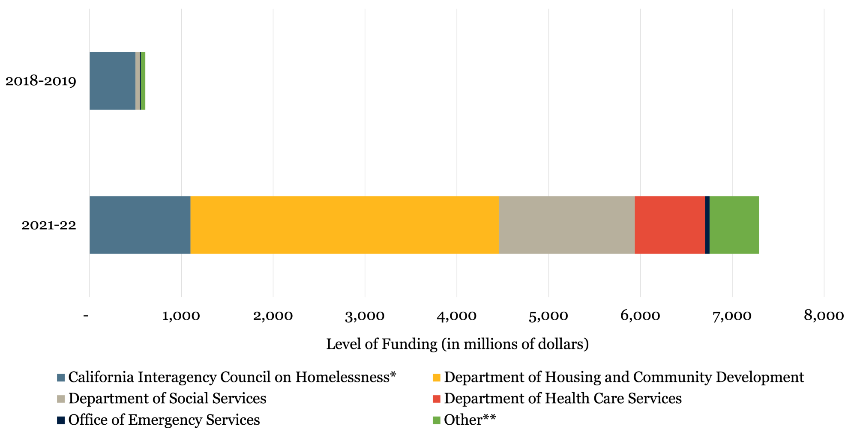
Government subsidy programs also lose effectiveness
In Los Angeles, it now costs upward of $600,000 per unit to build “affordable housing”
In San Francisco, a four-person household earning under $93,200 is eligible for very low-income housing (50% of area median income)
California spends billions of dollars annually on homelessness, but still has a homeless rate 3x greater than the US (LA is 4x and SF is 5.5x)
Source: Terner Center for Housing Innovation, “California’s Homekey Program: Unlocking Housing Opportunities for People Experiencing Homelessness”

Slide 41
“The best time to plant a tree was 20 years ago. The second best time is now.”
—Someone, sometime
As prices rise, options dwindle

Slide 42
“The best time to plant a treebuild a house was 20 years ago. The second best time is now.”
—Someone, sometimeMe
As prices rise, options dwindle

Slide 43
Homeownership
Home value appreciation proves to be a double-edged sword

Slide 44
Learn more with the UCLA Housing Voice Podcast
Mass Production and Suburbanization in Mexico, with Dinorah González (ep. 24)
When Auckland Upzoned Everywhere, with Ryan Greenaway-McGrevy (ep. 45)
Political Representation and Housing Supply, with Michael Hankinson (ep. 23)
Origins of the U.S. Mortgage Market (and Federal Bailouts), with Judge Glock (ep. 57)
Immigration and Housing Precarity with Carlos Delclós (ep. 50)

Slide 45
Learn more, and connect
shanephillips@ucla.edu
twitter: @shanedphillips
lewis.ucla.edu/subscribe

Slide 46
Homeownership’s benefits are unequally distributed

Slide 47
Building wealth through homeownership is a dead-end

Slide 48
Home value appreciation also has major downsides

Slide 49
Housing wealth and housing affordability are zero sum

Slide 50
If housing finance policy can support building wealth through homeownership, why not through renting too?

